Slide 1

Hexagonal Architecture
Ports and Adapters
Michael

Slide 2
Hexagonal Architecture
What is hexagonal architecture? (onion architecture and clean architecture)
How can we use hexagonal architecture in Suitefiles

Slide 3
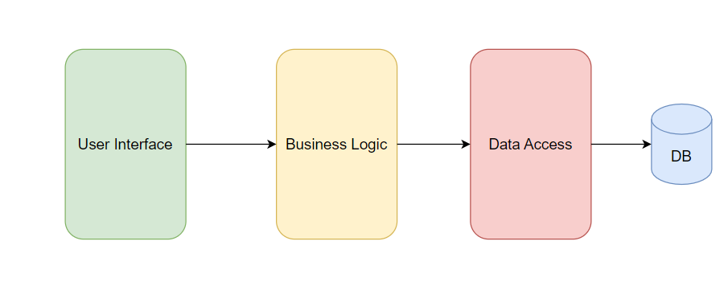
Layer Architecture (N-Tier Architecture)
The layered architecture style is one of the most common architectural styles. The idea behind Layered Architecture is that modules or components with similar functionalities are organized into horizontal layers. As a result, each layer performs a specific role within the application.

Slide 4

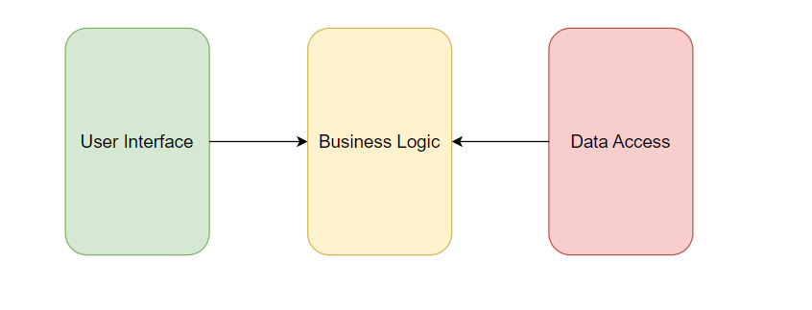

Slide 5
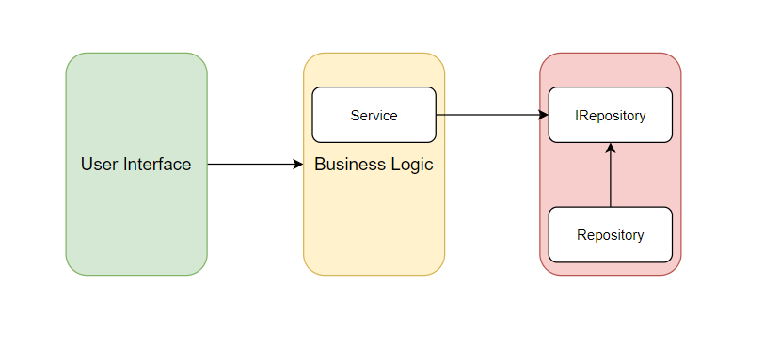

Slide 6
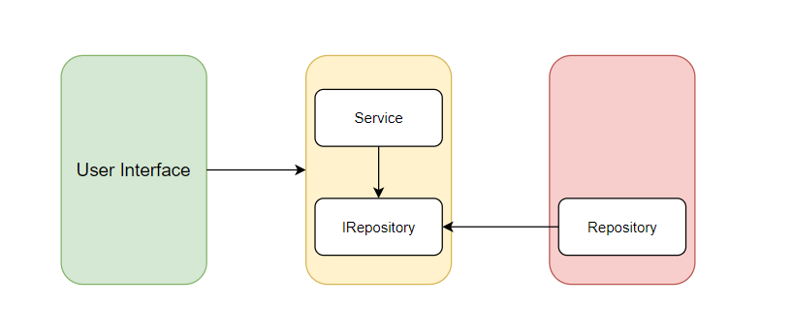

Slide 7
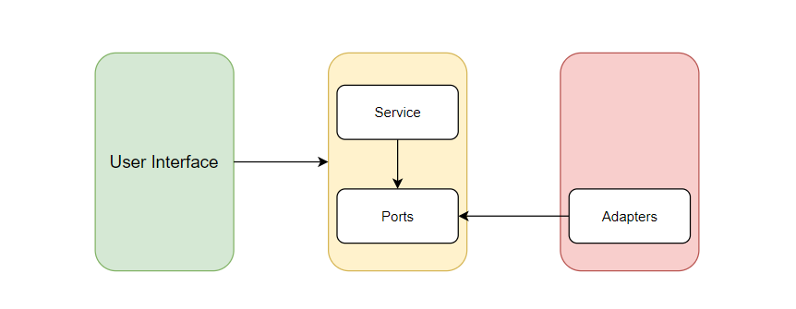

Slide 8
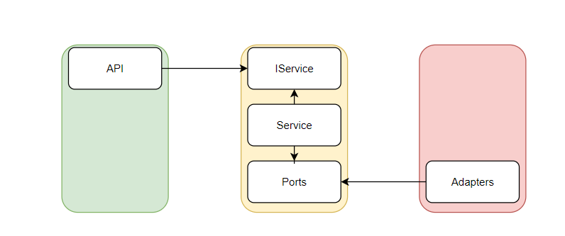

Slide 9
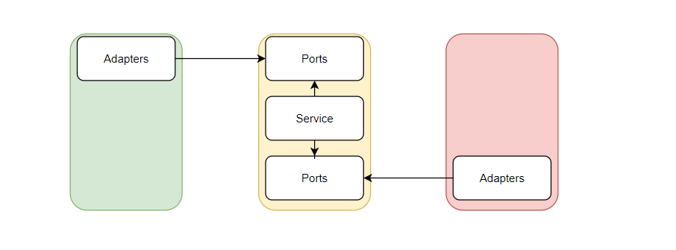

Slide 10
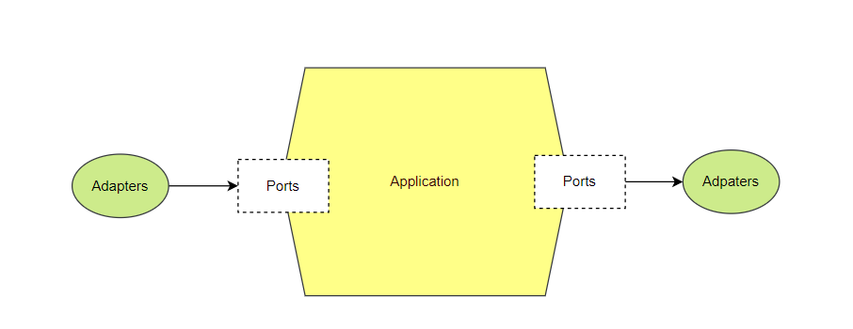

Slide 11
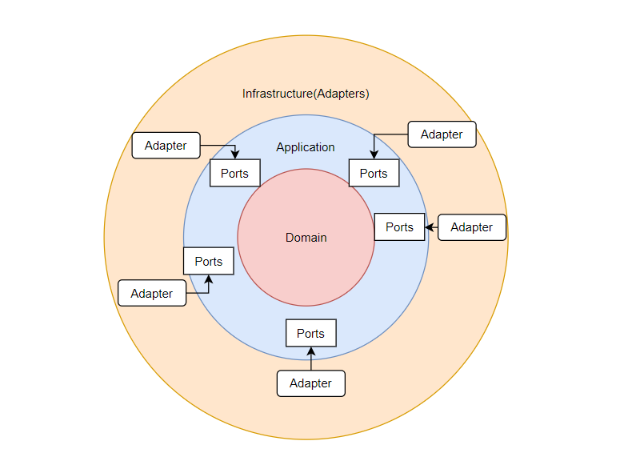
Hexgonal Architecture (with DDD)
The hexagonal architecture, or ports and adapters architecture, is an architectural pattern used in software design. It aims at creating loosely coupled application components that can be easily connected to their software environment by means of ports and adapters. This makes components exchangeable at any level and facilitates test automation.

Slide 12
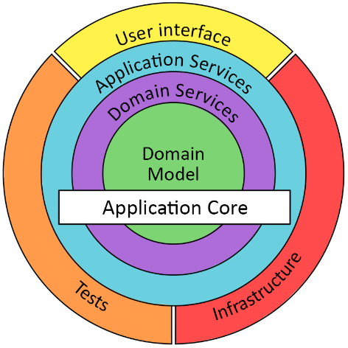
Onion Architecture
Domain layer (Domain entities/value object/ domain services)
Onion architecture is explaining more what it should be in the center layer.

Slide 13
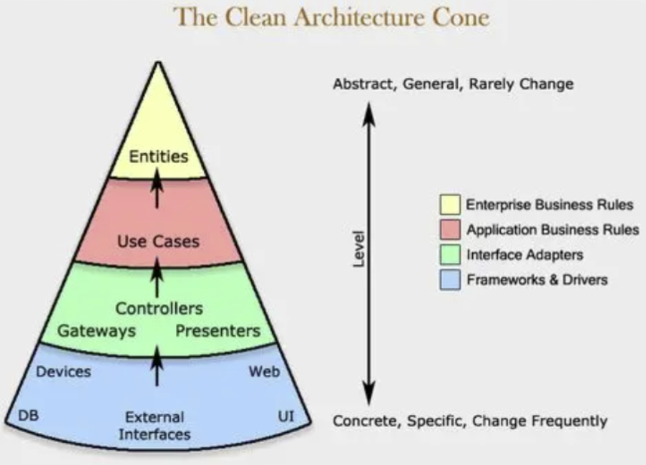
Clean Architecture
Application Layer (Use cases)
Domain layer (Domain entities/value object/ domain services)
Comparing to onion architecture, clean architecture’s application layer is more explained as use cases

Slide 14
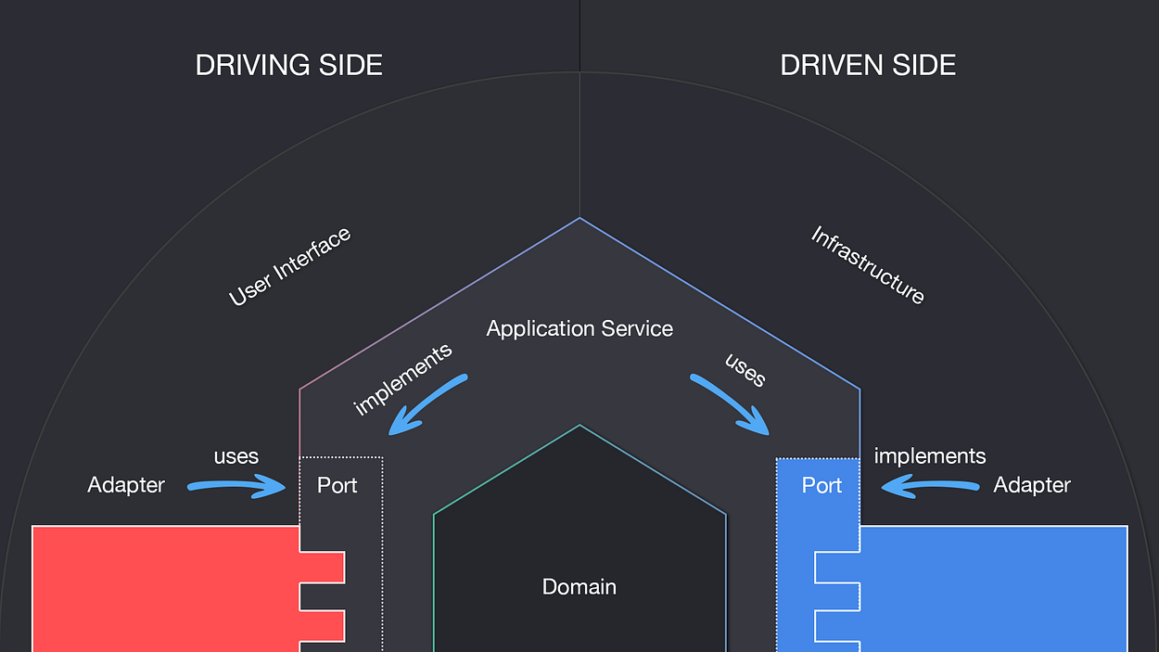
Driving side and Driven side
Driving (or primary) actors are the ones that initiate the interaction. For example, a driving adapter could be a controller which is the one that takes the (user) input and passes it to the Application via a Port.
Driven (or secondary) actors are the ones that are “kicked into behavior” by the Application. For example, a database Adapter is called by the Application so that it fetches a certain data set from persistence.

Slide 15
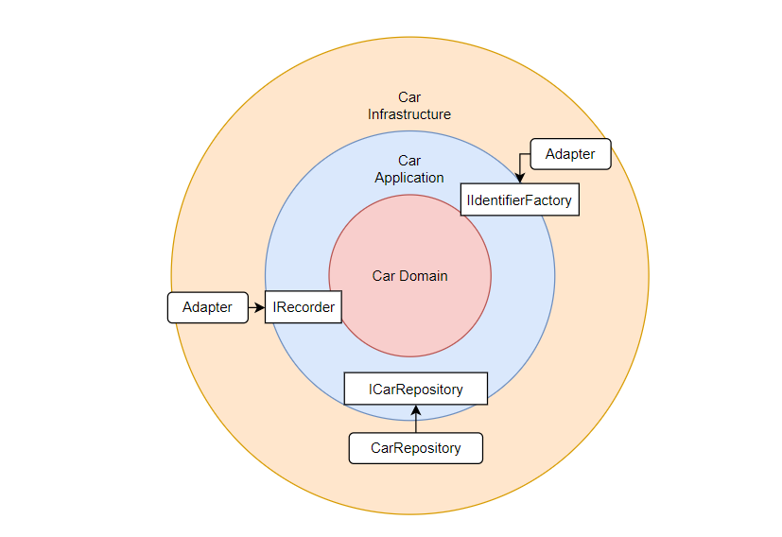
Real life example (SaaStack)

Slide 16
How can we use Hexagonal Architecture in SuiteFiles
Integrations

Slide 17
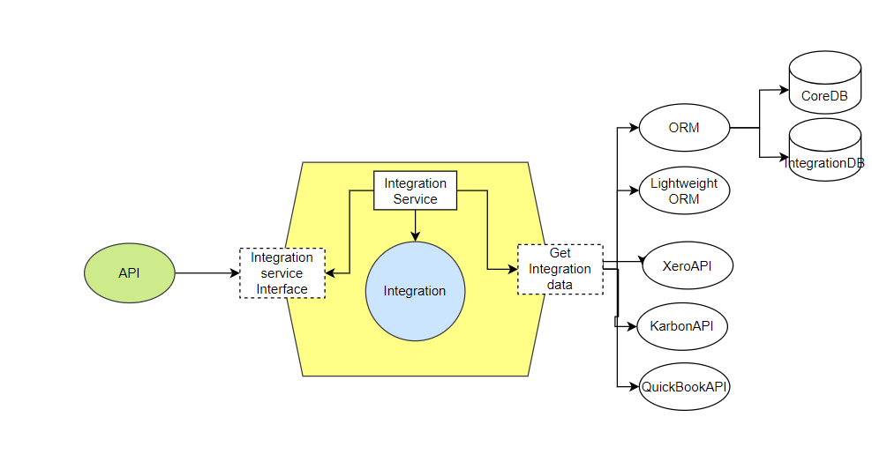
Integrations

